Slide 1

Small-Step Operational Semantics (SOS)
Rules to help you understand how core SML expressions are evaluated

Slide 2
Abstract Machines
An abstract machine consists of:
a set of states
a transition relation on states, written →
We read t → t′ as t evaluates to t′ in one step.
A state records all the information in the machine at a given moment.
For example, an abstract-machine-style description of a conventional microprocessor would include the program counter, the contents of the registers, the contents of main memory, and the machine code program being executed.

Slide 3
Overview
We will define a set of syntax-directed rules that will enable expressions to be reduced one (atomic) computational step at a time.
Our rule set will consist of two types of rules.
Computation rules perform “real” computation steps.
Congruence rules determine where computation rules can be applied next.
We will consider the expressions we are working with to be in term form.
A program will consist of a single term.
The term being evaluated denotes the entire program state.

Slide 4
Boolean Operators
if-then-else, orelse, andalso, not

Slide 5
computation rule
if true then t₂ else t₃ → t₂
computation rule
if false then t₂ else t₃ → t₃
t₁ → t₁′
congruence rule
if t₁ then t₂ else t₃ → if t₁′ then t₂ else t₃

Slide 6
true orelse t → true
true andalso t → t
false orelse t → t
false andalso t → false
t₁ → t₁′
t₁ → t₁′
t₁ orelse t₂ → t₁′ orelse t₂
t₁ andalso t₂ → t₁′ andalso t₂

Slide 7
not true → false
not false → true
t → t′
not t → not t′

Slide 8
Implementation in SML
datatype boolean = cond of boolean * boolean * boolean
| lor of boolean * boolean
| land of boolean * boolean
| neg of boolean
| value of bool;

Slide 9
fun step ( neg(value true ) ) = value false
| step ( neg(value false) ) = value true
| step ( neg t ) = neg (step t)
| step ( land(value true , t ) ) = t
| step ( land(value false, t ) ) = value false
| step ( land(t1 , t2) ) = land( step t1, t2 )
| step ( lor(value true , t ) ) = value true
| step ( lor(value false, t ) ) = t
| step ( lor(t1 , t2) ) = lor( step t1, t2 )
| step ( cond(value true , t1, t2) ) = t1
| step ( cond(value false, t1, t2) ) = t2
| step ( cond(t0 , t1, t2) ) = cond( step t0, t1, t2 );

Slide 10
fun eval ( value v ) = v
| eval t = eval( step t );
val expr1 = lor( land( value true, value false ), value true );
val expr2 = lor( land( value true, value false ), value false );
val expr3 = cond(expr1, expr2, expr1);
eval expr1;
eval expr2;
eval expr3;

Slide 11
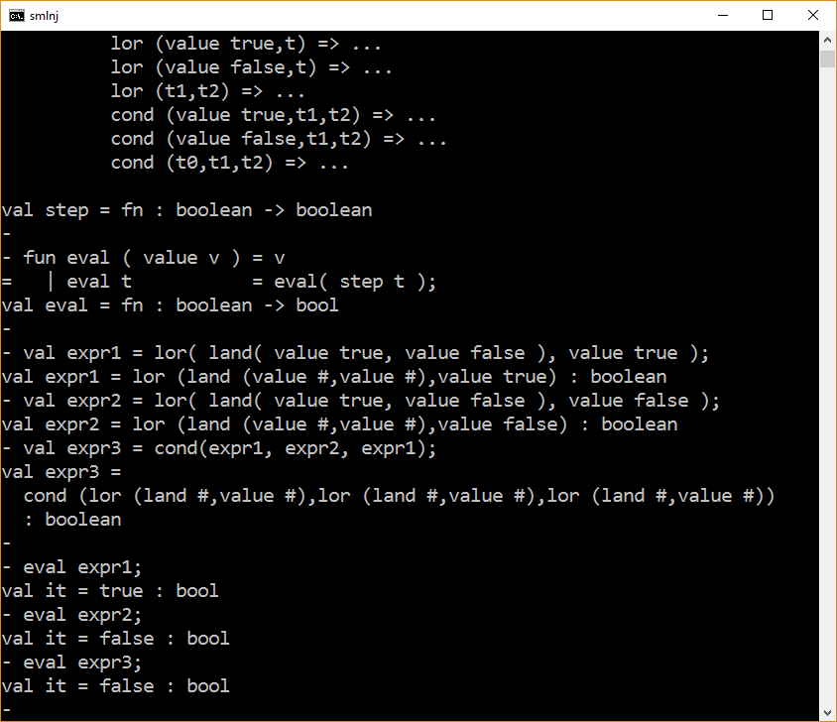

Slide 12
Relational Operators
=, <>, <, <=, >, >=

Slide 13
v = v → true
v <> v → false
v₁ = v₂ → false
v₁ <> v₂ → true
t₂ → t₂′
t₂ → t₂′
v₁ = t₂ → v₁ = t₂′
v₁ <> t₂ → v₁ <> t₂′
t₁ → t₁′
t₁ → t₁′
t₁ = t₂ → t₁′ = t₂
t₁ <> t₂ → t₁′ <> t₂

Slide 14
Arithmetic Operators
+, −, ∗, div, mod, ∼

Slide 15
result = compute(v₁ + v₂)
result = compute(v₁ − v₂)
v₁ + v₂ → result
v₁ − v₂ → result
t₂ → t₂′
t₂ → t₂′
v₁ + t₂ → v₁ + t₂′
v₁ − t₂ → v₁ − t₂′
t₁ → t₁′
t₁ → t₁′
t₁ + t₂ → t₁′ + t₂
t₁ − t₂ → t₁′ − t₂

Slide 16
result = compute(v₁ ∗ v₂)
v₁ ∗ v₂ → result
t₂ → t₂′
v₁ ∗ t₂ → v₁ ∗ t₂′
t₁ → t₁′
t₁ ∗ t₂ → t₁′ ∗ t₂

Slide 17
result = compute(v₁ div v₂)
result = compute(v₁ mod v₂)
v₁ div v₂ → result
v₁ mod v₂ → result
t₂ → t₂′
t₂ → t₂′
v₁ div t₂ → v₁ div t₂′
v₁ mod t₂ → v₁ mod t₂′
t₁ → t₁′
t₁ → t₁′
t₁ div t₂ → t₁′ div t₂
t₁ mod t₂ → t₁′ mod t₂

Slide 18
Function application

Slide 19
Simplifying assumptions
We assume that the formal parameter of a function value is a single variable (e.g., as oppose to a matching pattern)
We assume that all variables are unique and that renaming of variables (i.e., alpha-conversion) takes place as needed to assure this property.

Slide 20
σ = [x := v]
(fn x => t) v → σ( t )
t₂ → t₂′
v₁ t₂ → v₁ t₂′
t₁ → t₁′
t₁ t₂ → t₁′ t₂

Slide 21

Examples
Come on, Donkey. I'm right here beside ya, okay? For emotional support, we'll just tackle this thing together one little baby step at a time.
-Really?
-Really, really.
SOS evaluation – One step at a time

Slide 22
Example
2 + 3 ∗ 5
→ 2 + 15
→ 17

Slide 23
Example
(fn x => 1 div 0)

Slide 24
Example
(fn x => x + 2) 3 ∗ 5
→ (3 + 2) ∗ 5
→ 5 ∗ 5
→ 25

Slide 25
Example
(if true then (fn x => x + 2) else (fn x => x)) (3 ∗ 5)
→ (fn x => x + 2) (3 ∗ 5)
→ (fn x => x + 2) 15
→ 15 + 2
→ 17

Slide 26
Example
(fn x => (fn y => y + x) x) 3
→ (fn y => y + 3) 3
→ 3 + 3
→ 6

Slide 27
The end

